Slide 1

SMART – MOM
Members:
Amit Garg
Maaz Sirkhot
Shriya Vanvari
Shubham Kumar

Slide 2
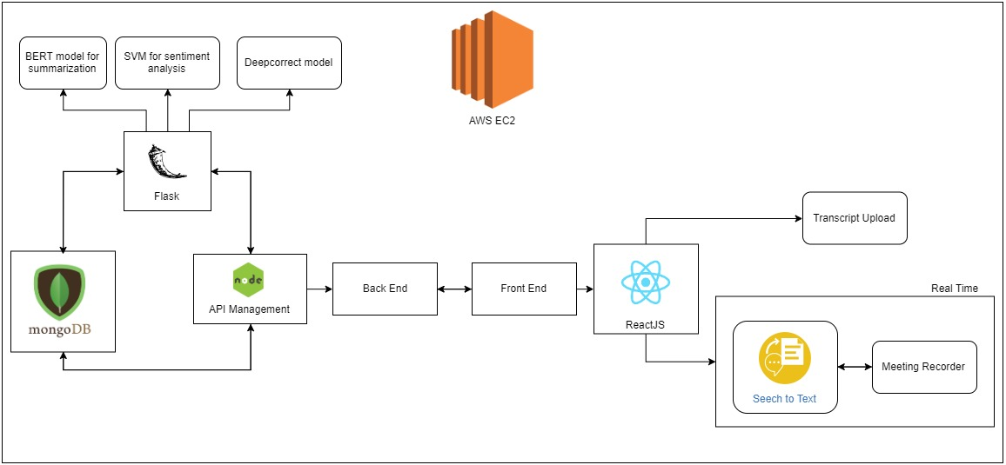
Architecture

Slide 3
Future Scope
Plug-in extension for other meeting applications
Ability to collaborate and assign tasks automatically
Send Minutes of Meeting as an email to required stakeholders

Slide 4
Thank You

